Slide 1
Notes:
This is a bad news lesson…paint it black.

Slide 2
Thorns & Thistles
In Genesis 1-2, Adam and Eve worked in the garden in an environment of shalom (peace). But that peace was conditioned upon their obedience to God’s command. They were to keep (guard) the garden through their obedience to his command.

Slide 3
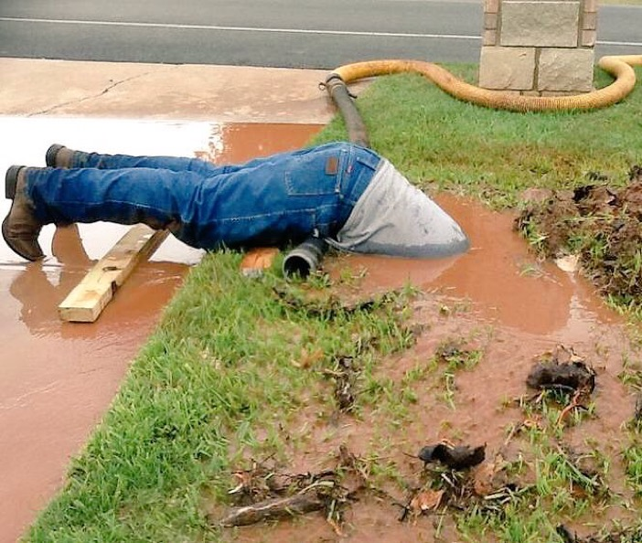

Slide 4
Thorns & Thistles
When Adam and Eve sinned in the garden, every aspect of creation was affected. Peace was replaced with a curse. Everything in creation was affected by the Fall, including work.

Slide 5
Thorns & Thistles
“…cursed is the ground because of you; in pain you shall eat of it all the days of your life; thorns and thistles it shall bring forth for you; and you shall eat the plants of the field. By the sweat of your face you shall eat bread, till you return to the ground, for out of it you were taken; for you are dust, and to dust you shall return.” (Gen. 3:17-19)
“…creation was subjected to futility…” (Rom. 8:20)

Slide 6
Thorns & Thistles
God’s curse does not remove all of work’s benefits (it still meets our physical needs), but work also produces “thorns and thistles,” which symbolize the painful, unintended consequences of work.
Notes:
Don’t miss this important point…while work is under the curse, it is not a curse. There is a big distinction there. Child bearing is also under the curse, but no one would say that having children is a curse (at least most days!)
Work still provides tangible blessings, but it also brings unintended painful consequences. That’s the imagery of thorns and thistles. No one plans to grow thorns and thistles.

Slide 7
Thorns & Thistles
Some of the “thorns and thistles” we experience with our work include:
  Anxiety, illness, injury and exhaustion
Notes:
Anxiety = direct consequence of trying to be God like

Slide 8
Thorns & Thistles
“What has a man from all the toil and striving of heart with which he toils beneath the sun? For all his days are full of sorrow, and his work is a vexation. Even in the night his heart does not rest. This also is vanity.” (Ecclesiastes 2:22-23)
Notes:
Solomon points out what we all experience…work under the sun in this fallen world takes a toll on us emotionally and physically. We are never really far from it. Emails and text messages follows us home. Our cell phones ring all day and evening. Even while we are sleeping we are often thinking about it in our subconscious. Work is literally killing us. Each year in the US almost 5,000 people die in accidents on the job, over 50,000 die from illnesses caused by exposure to toxins in the workplace. Stress from the job causes a 35% increase in being diagnosed with a major illness and 20% more likely to die from a heart attack or stroke.

Slide 9
Thorns & Thistles
Some of the “thorns and thistles” we experience with our work include:
  Anxiety, illness, injury and exhaustion
  A sense of pointlessness
Notes:
Remember, work as originally conceived by God was purposed toward the mission of God. But because after the Fall work becomes about us, it can seem futile and pointless because it is not pointed where it needs to be (toward God!) The mission of “self” will never be more satisfying that the mission of God.

Slide 10
Thorns & Thistles
“So I hated life, because what is done under the sun was grievous to me, for all is vanity and a striving after wind.” (Ecclesiastes 2:17)
Notes:
“Striving after the wind” = chasing something you will never catch.

Slide 11
Thorns & Thistles
Some of the “thorns and thistles” we experience with our work include:
  Anxiety, illness, injury and exhaustion
  A sense of pointlessness
  Envy of others
Notes:
Remember that the original plan was for Adam and Eve to be fruitful and multiply so that they gave birth to a generation of fellow workers at peace with one another collaborating to serve the mission of God, to keep the Garden and subdue the world. But now peace has been lost between our fellow workers. Competition has replaced collaboration. We see others’ gains as our losses. Work also becomes the means through which we can outdo one another's’ lifestyles.

Slide 12
Thorns & Thistles
“Then I saw that all toil and all skill in work come from a man’s envy of his neighbor. This also is vanity and a striving after wind.” (Ecclesiastes 4:4)

Slide 13
Thorns & Thistles
Some of the “thorns and thistles” we experience with our work include:
  Anxiety, illness, injury and exhaustion
  A sense of pointlessness
  Envy of others
  Confusing work with identity
Notes:
Work no longer is a reflection of who we are (image bearers) but has become the way in which we know each other. Before the Fall, we worked out of our identity not to gain one. What is one of the first questions you ask someone you just met? “What do you do?”

Slide 14
Thorns & Thistles
“Come, let us build ourselves a city and a tower with its top in the heavens, and let us make a name for ourselves, lest we be dispersed over the face of the whole earth.” (Gen. 11:4)
Notes:
What you see in the story of the Tower of Babel is the sinful tendency that we have to repeat the sin of Adam and Eve to try and be god-like through our work (reaching to heaven, the domain of God) and to be independent of God by distinguishing ourselves based on our work.

Slide 15
Thorns & Thistles
Some of the “thorns and thistles” we experience with our work include:
  Anxiety, illness, injury and exhaustion
  A sense of pointlessness
  Envy of others
  Confusing work with identity
  Making work an idol.

Slide 16
Thorns & Thistles
“We have an alternate or counterfeit god if we take anything in creation and begin to “bow down” to it – that is, to love serve and derive meaning from it more than from the true God.” Tim Keller – Every Good Endeavor

Slide 17
Thorns & Thistles
“…for my people have committed two evils:
they have forsaken me,
the fountain of living waters,
and hewed out cisterns for themselves,
broken cisterns that can hold no water.”
Jeremiah 2:13
Notes:
Notice there are two parts to idolatry: 1) rejecting God as your source of “life” and 2) finding life in a created thing, like work.

Slide 18
Thorns & Thistles
But there is good news! Through the redeeming actions of Jesus Christ, God is overcoming all brokenness caused by sin.
“Behold, I am making all things new.” (Revelation 21:5)
Notes:
We have spent the whole time together today talking about the bad news as it relates to work. If we really believe the bad news, then we ought to be craving some good news right now. We'll talk more about that next week, but now that the Gospel is our only hope to undo the effects of the Fall on work.

Slide 19
Final Thoughts
Summary: Work has been made futile because of the Fall and the presence of sin in us. Work no longer fulfills its purpose. And work is under a curse so that in various ways it now causes us physical, emotional, relational and spiritual pain.

